Slide 1


Introduction to Power Platform Low Code Evolution
Umang Shah (MCP )
https://www.linkedin.com/in/umangsharepoint/

Slide 2
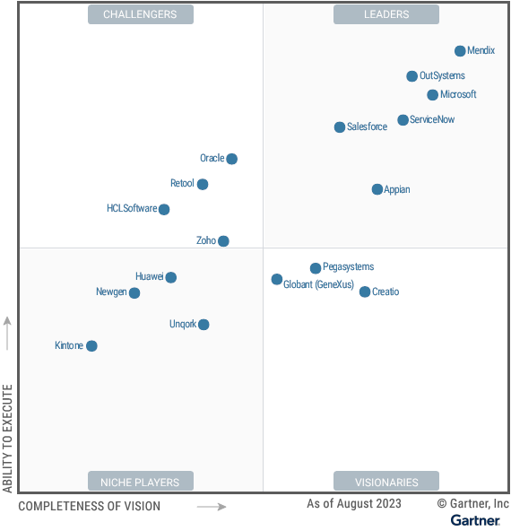
Low Code Evolution
By 2024, Gartner predicts that a massive 65% of application development activity will be driven by no-code platforms. Gartner predicts the global market for low-code solutions will reach a staggering $26.9 billion in 2023, a significant 19.6% increase year-over-year, and will continue to rise in 2024

Slide 3

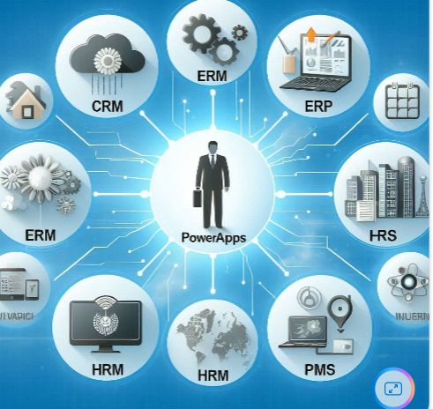
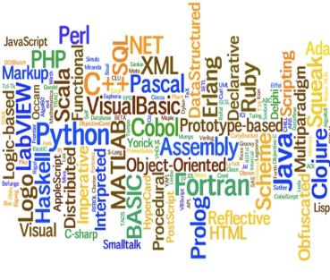

The evolution of how people buy applications
Custom Software
Packaged Software
Low-code Development
What development language do you use?
How feature rich is your software?
How agile and extensible is your platform?

Slide 4
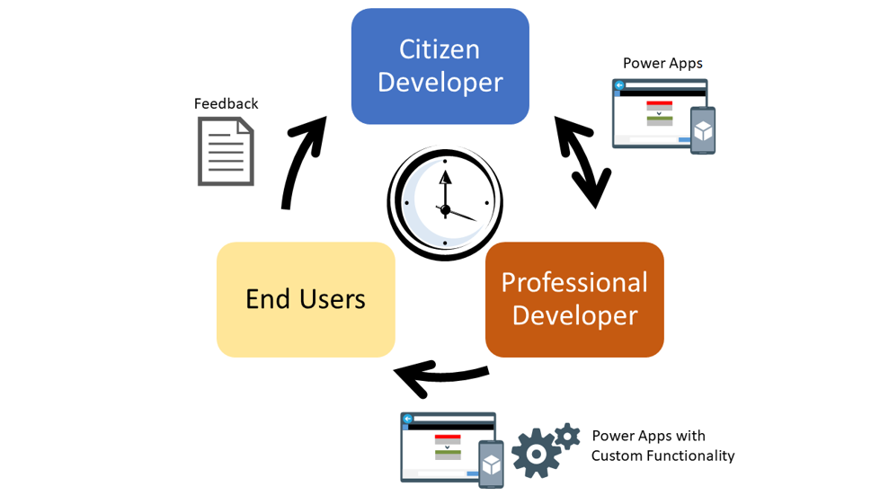
Rapid Application Development

Slide 5
Benefits of low-code development platforms
Environment used to create web or mobile applications easily by mostly configurations, drop-and drops.
LOW-CODE
DEVELOPMENT PLATFORMS
Higher rate of success
Loved by both Business & IT
Breeds Innovations
Days to Weeks
Success Rate
Time to Live
Business Relevance
Innovative Culture
Traditional computer programming, writing lines of codes from scratch.
Failed projects are common
Lagging IT & constant tension with business
TRADITIONAL
DEVELOPMENT
Months to Years
Curbs Innovation

Slide 6
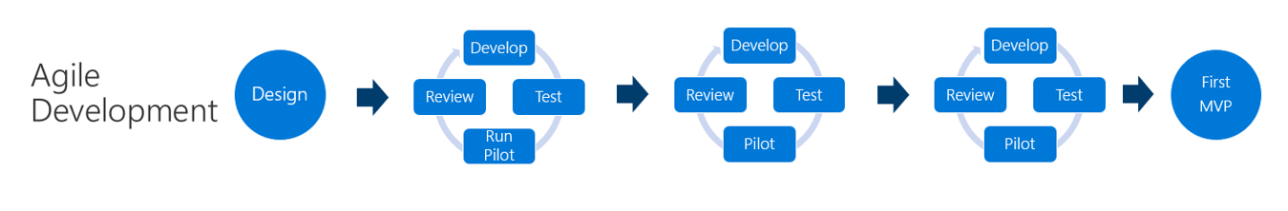
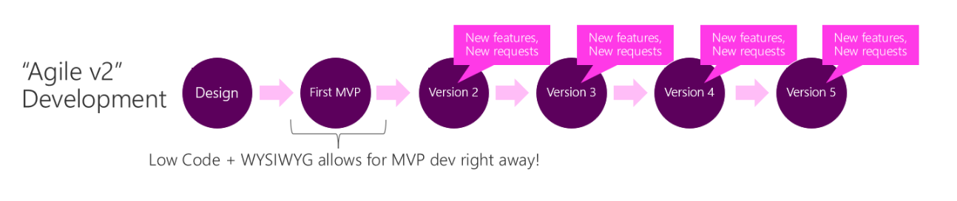
Why Power Platform /Any low code platform?
Time
Resources
Cost
Data
Maintenance

Slide 7

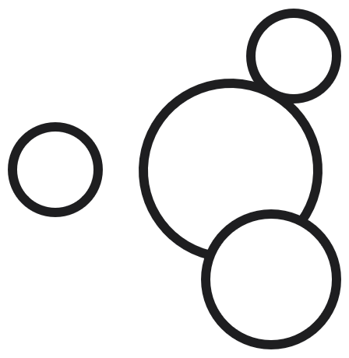

Microsoft Power Platform
The low-code platform that spans Office 365, Azure, Dynamics 365, and standalone applications
Innovation anywhere. Unlocks value everywhere. – Evolved from This
Power BI
Business analytics
Power Apps
Application development
Power Automate
Process automation
Power Virtual Agents
Intelligent virtual agents– Now Copilot
Data
connectors
Portal – Pages
AI Builder
Common
Data Service -- Dataverse

Slide 8
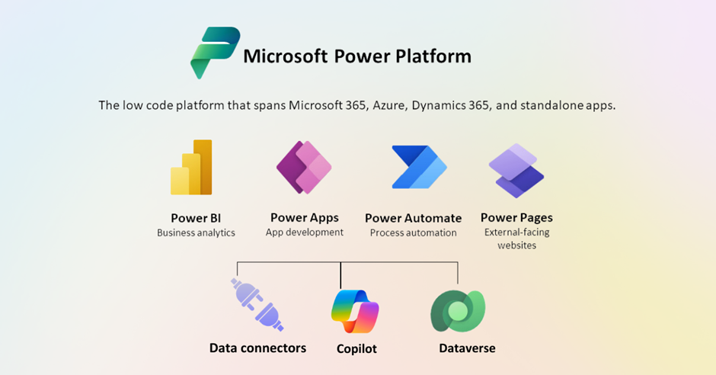
To – This (Latest)

Slide 9
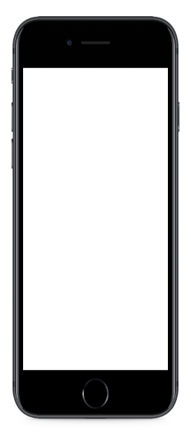
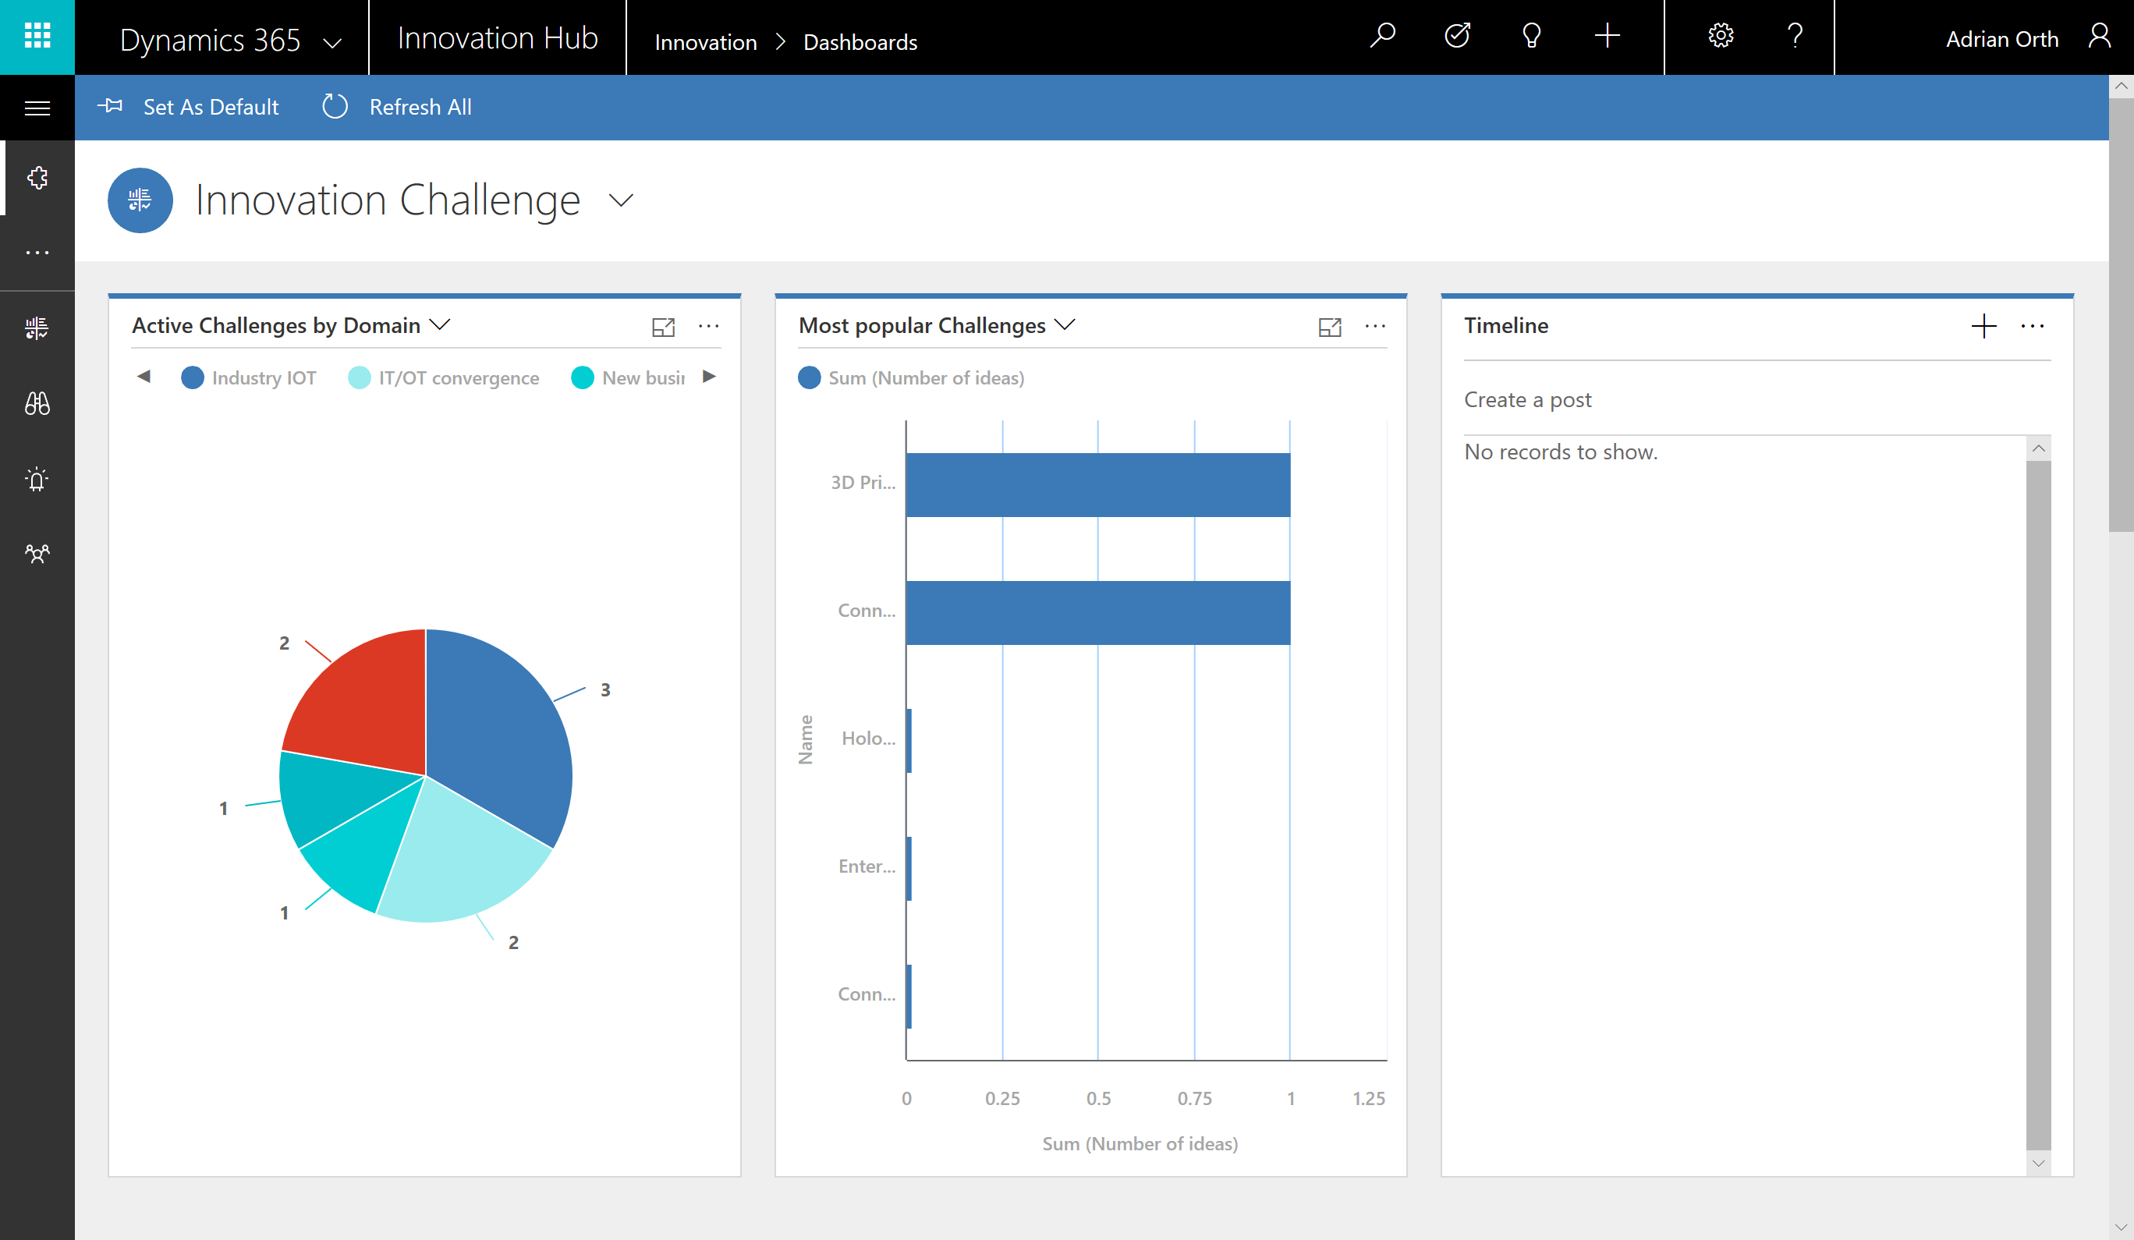

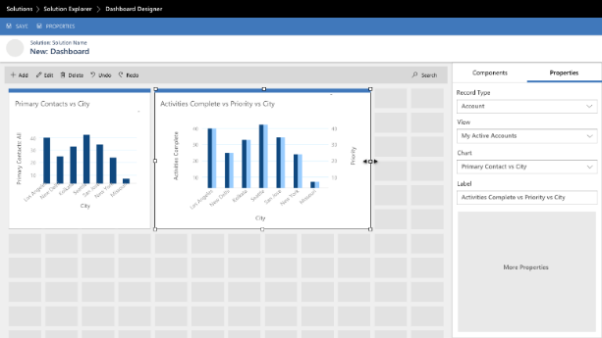
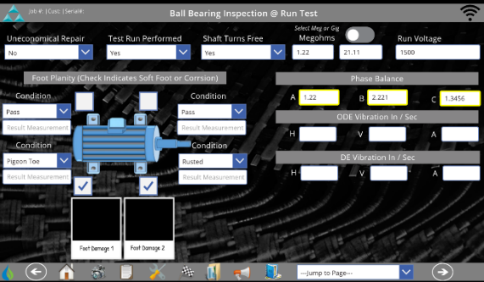
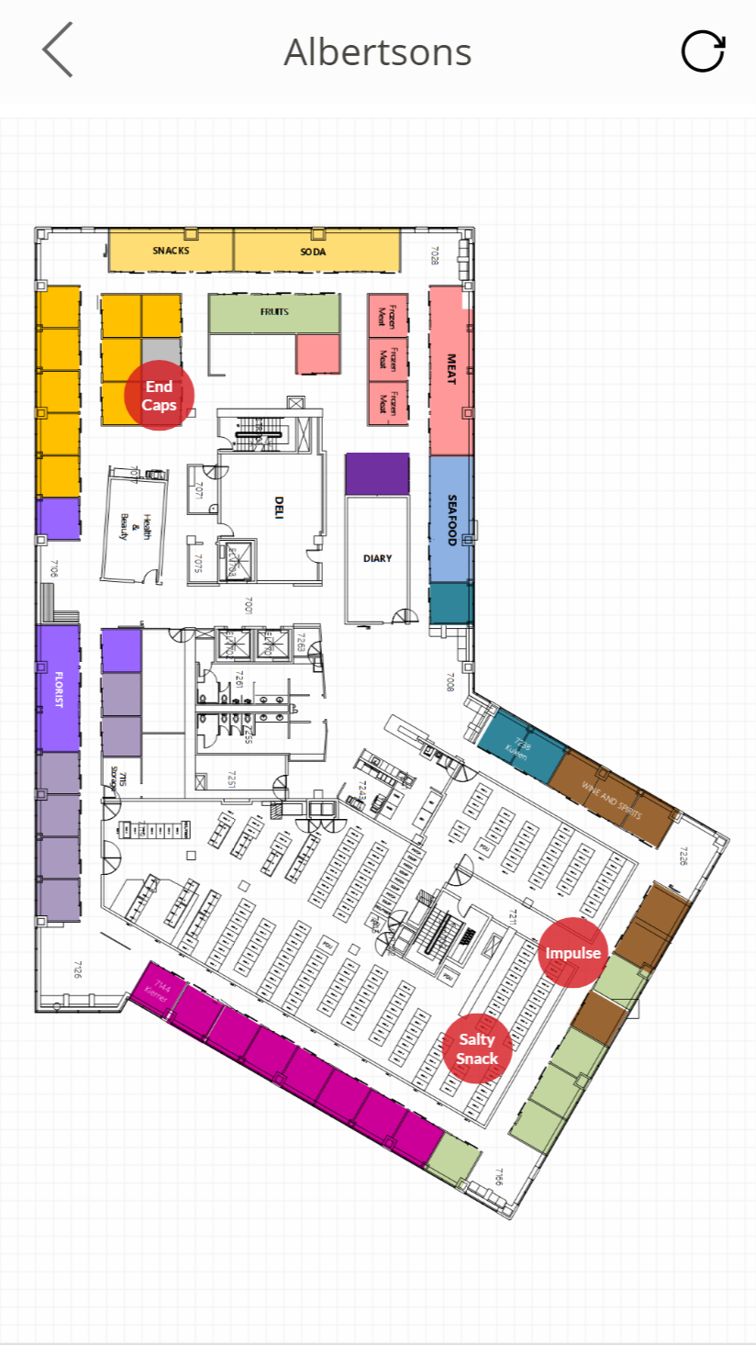
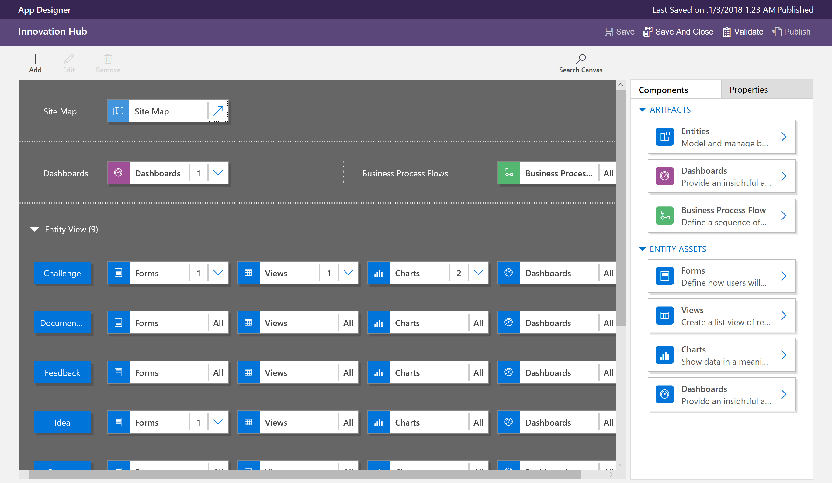
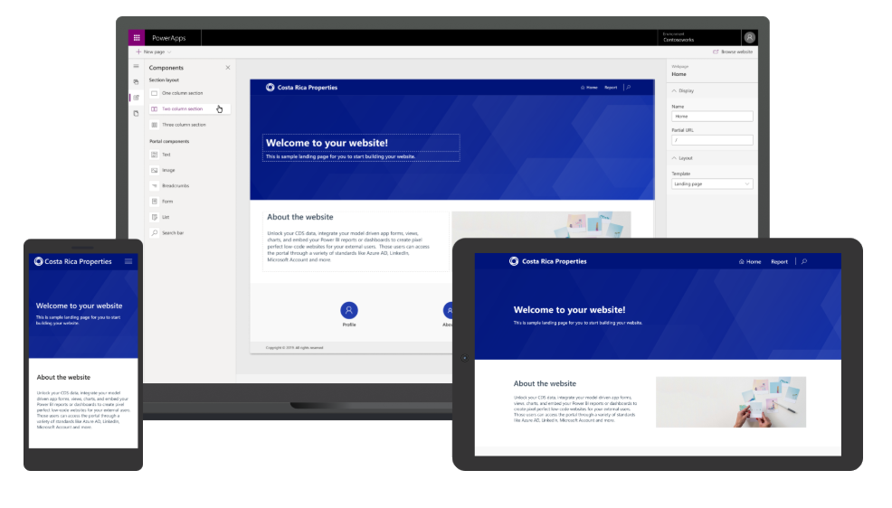
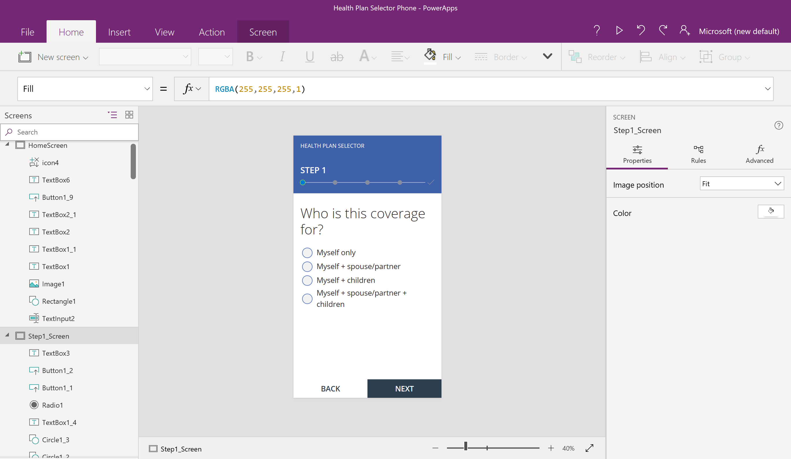
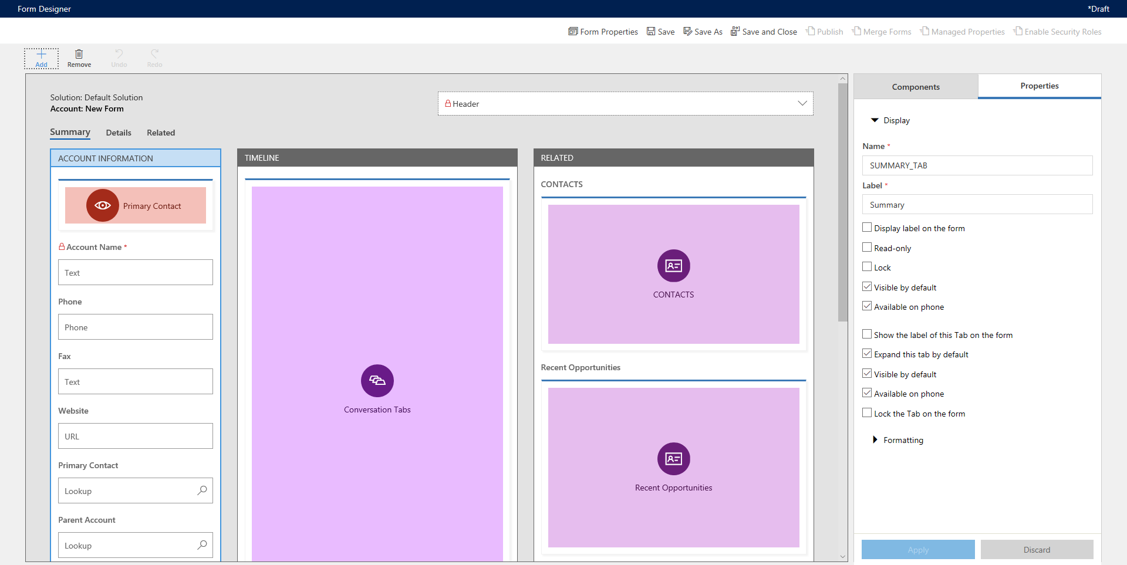
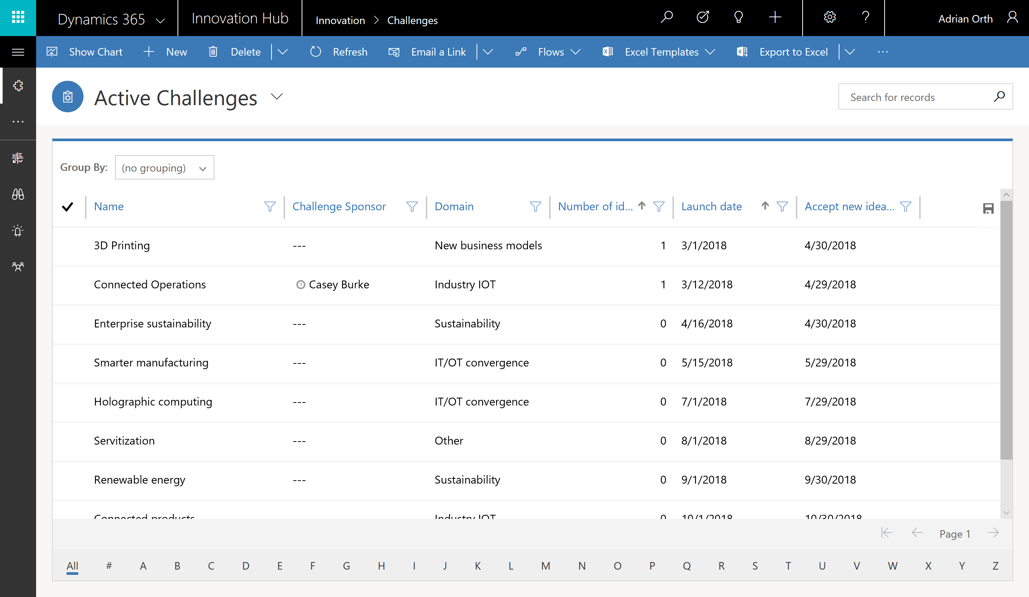
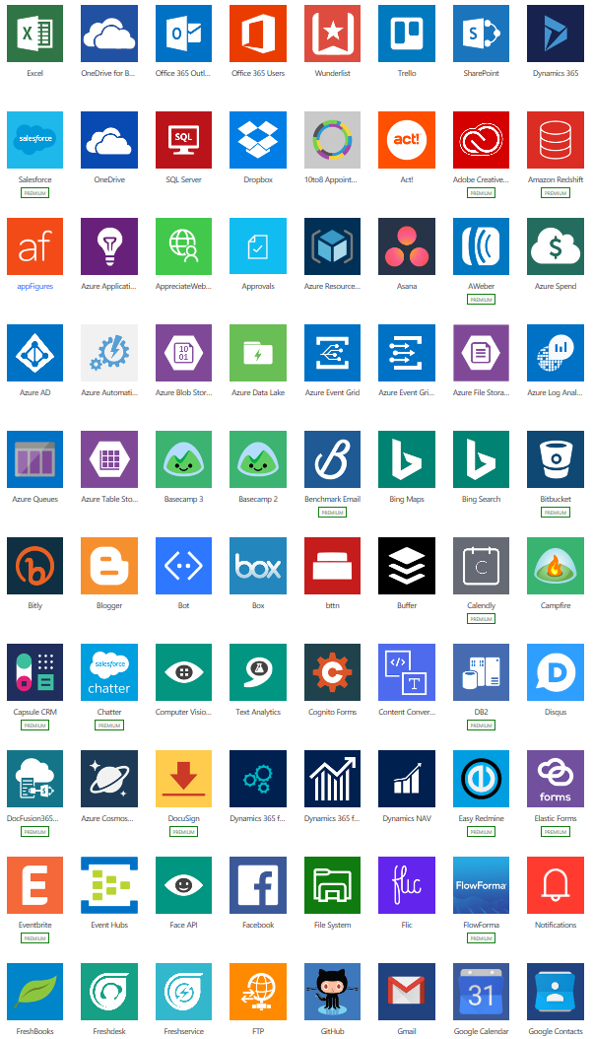
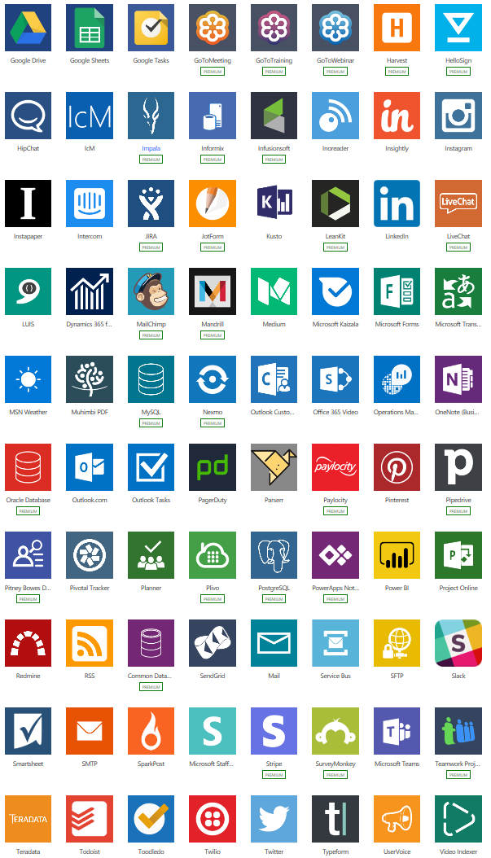
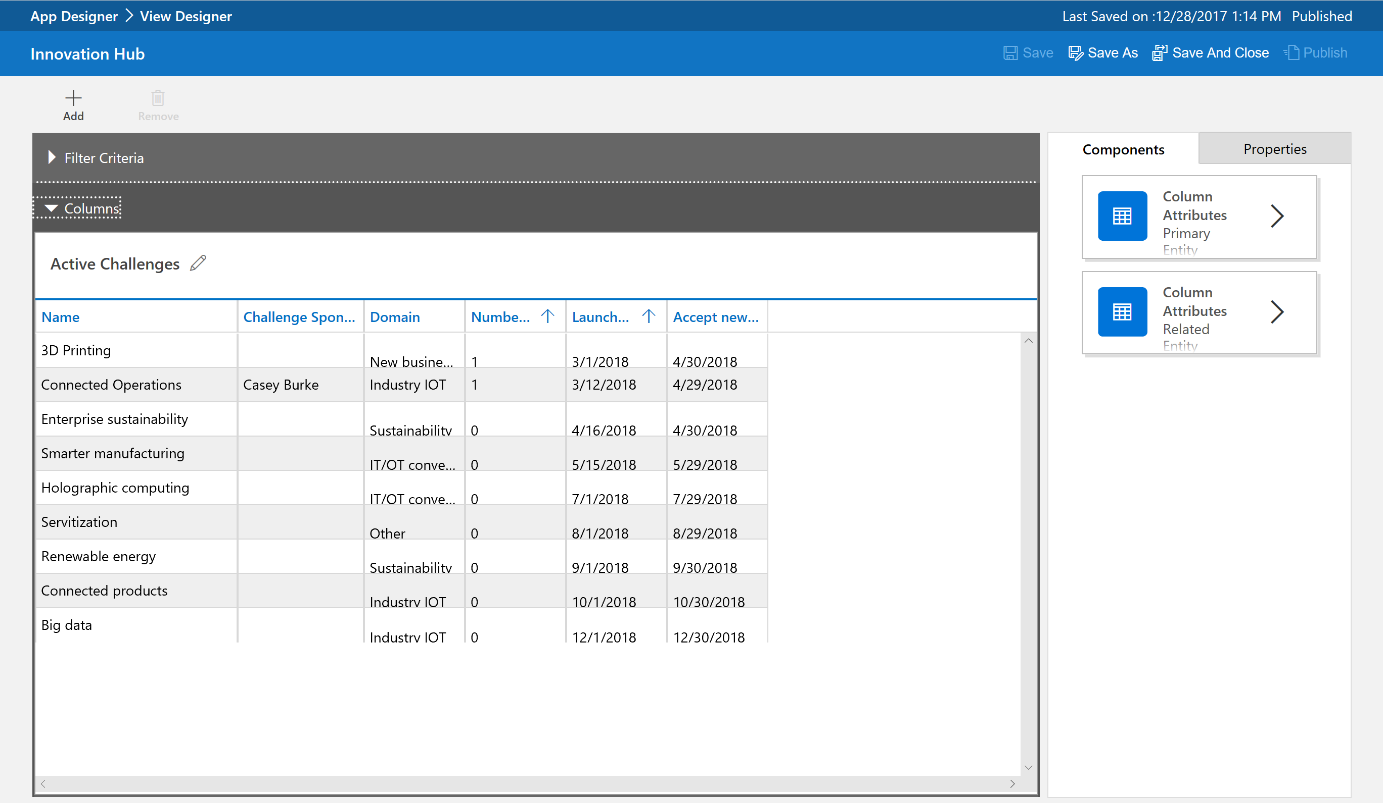
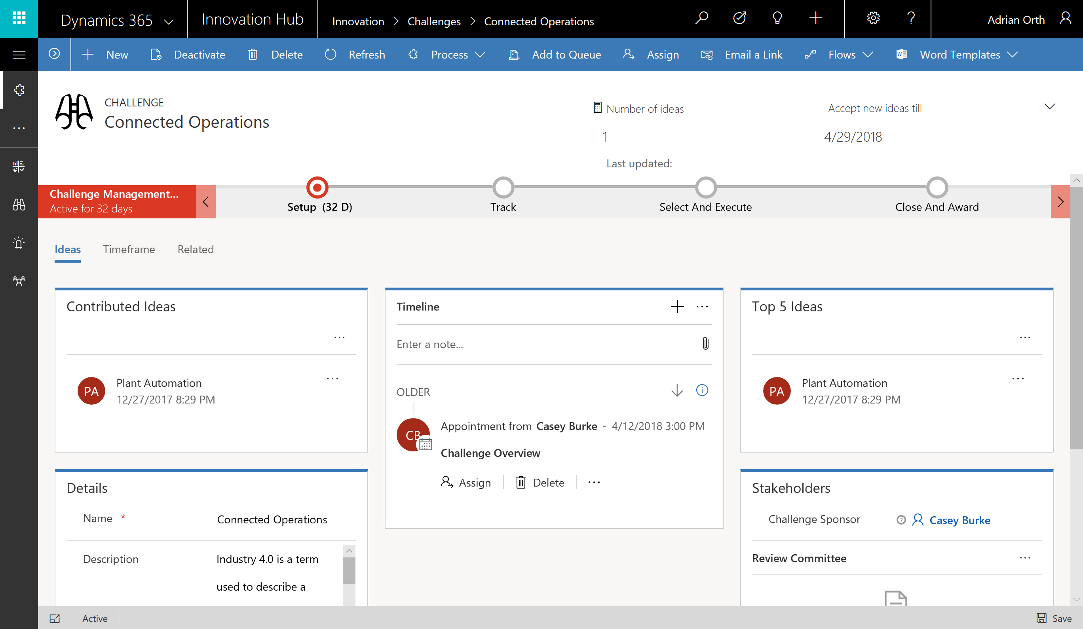



Types of Power Apps
Canvas Apps
Start with user experience in mind.
Build Pixel Perfect Apps, full control over the App Design.
Build Task-based & role-based apps.
Mash-up data from 600+ data sources.
Model-driven Apps
Built on Microsoft Dataverse.
Start with a data model, build relationships and business processes.
Build End-to-End business applications.
Build Immersive and responsive applications.
Power Apps Portals-- Pages
Web based apps that allow internal and external access to view and update data within Dataverse.
Build websites with anonymous access.
Microsoft Dataverse based.

Slide 10
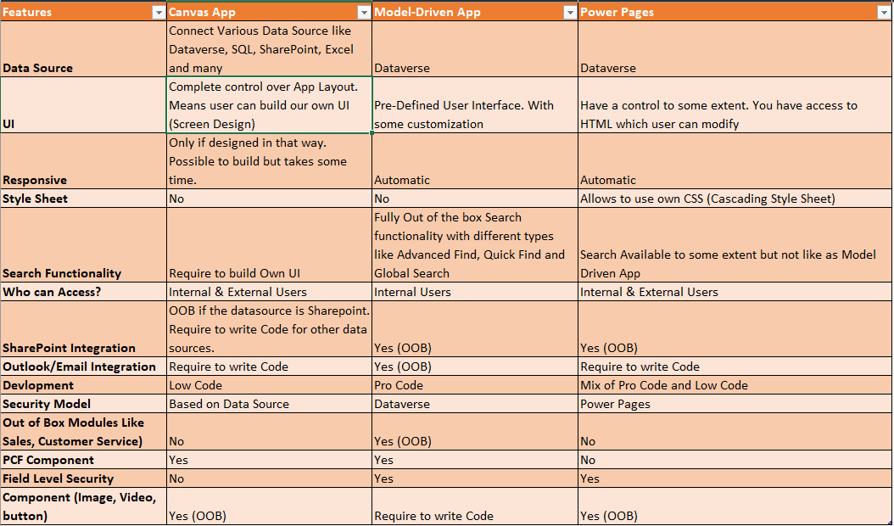

Slide 11
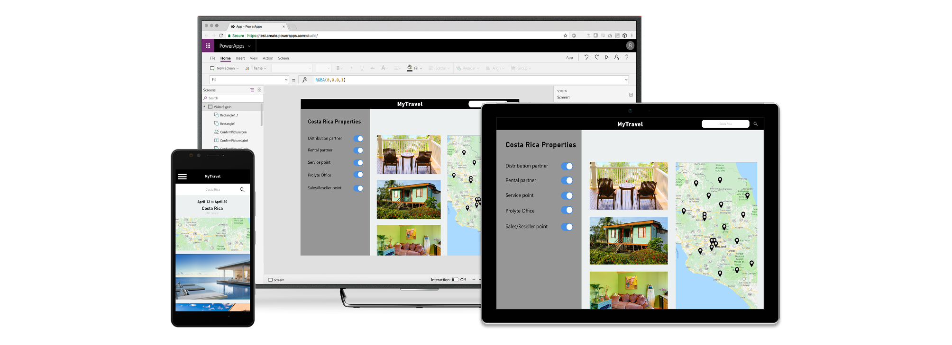
Build apps for web and mobile with Power Apps
Easily build web & mobile apps with a full featured low-code/no-code development experience.
Empower business users to solve their own problems and easily share apps while maintaining security & governance.
Publish instantly to iOS, Android, Windows, and the web.
Sharing apps is like sharing documents.
Manage across environments.

Slide 12
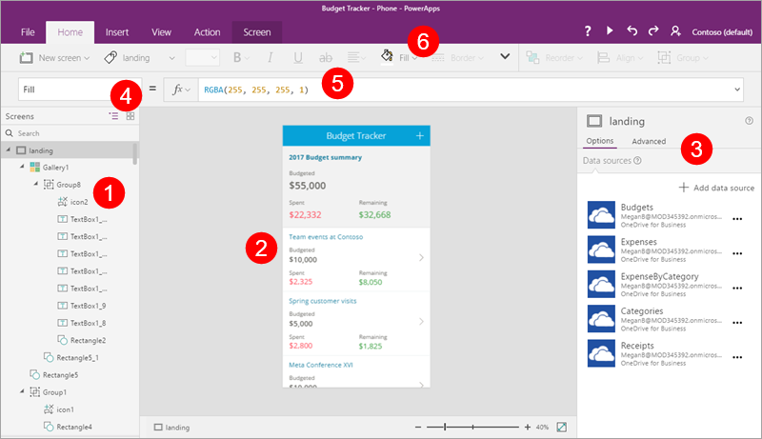
1. Canvas Apps
Create Screens/components
Connect to a list
Gallery configuration
Property type
Property formula
Ribbons control

Slide 13

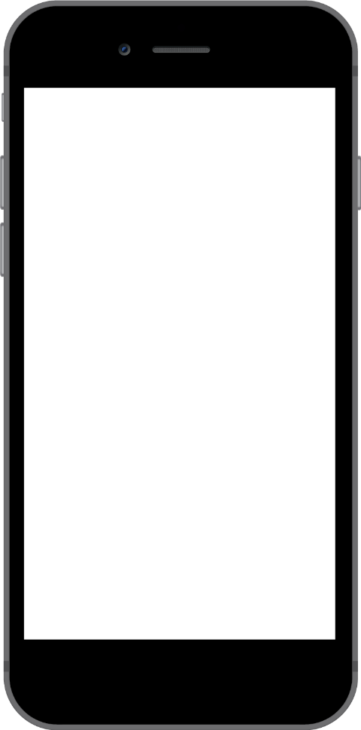
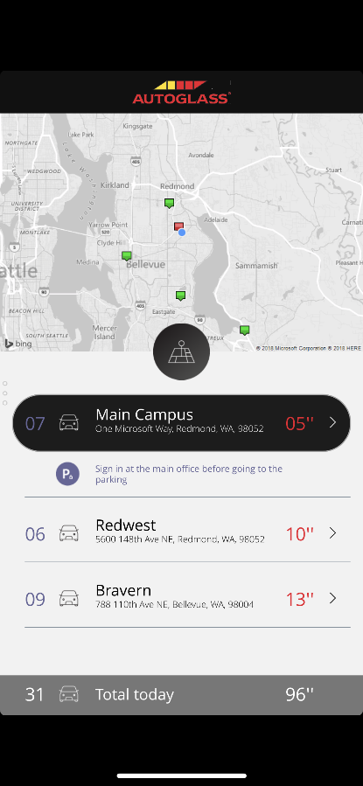
Anatomy of a Canvas app
WYSIWYG design experience
PowerPoint like pixel perfect drag and drop design experience. Start from a template, app is running with live data as you build it
Any platform support
Supports all major platforms and gives native access to device capabilities like camera, GPS,
pen & ink
Data connectivity
Connect to hundreds of services and apps with built-in connectors. Over 600+ connectors available.
Share apps like documents
Share your app with 3 clicks and an email address. It’s pushed to mobile devices in seconds
Built-in data platform
Use Dataverse
to store app data in a standardized Common Data Model
Seamless integration
Directly integrated with Power Automate, Power BI, Microsoft Teams, Office 365, Dynamics 365 & Azure
App logic
If you can understand formulas in Excel, you can add logic to your Power App.
Leverage AI Builder to democratize AI in your org
Extensibility model
No limits. Get a pro-dev to build you a control or connector if you need something custom

Slide 14
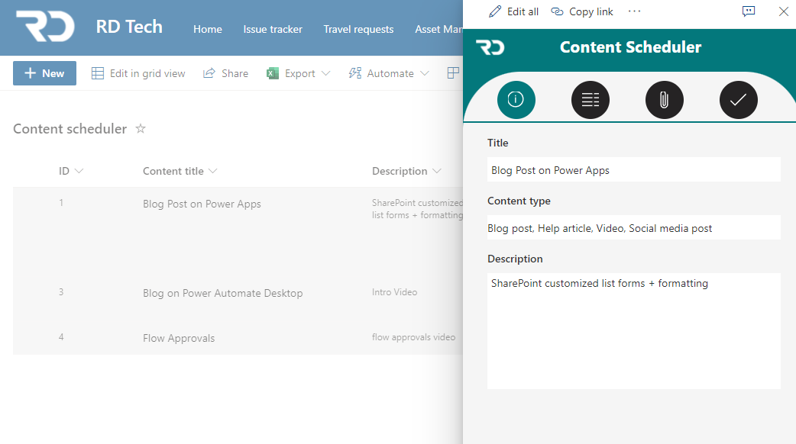
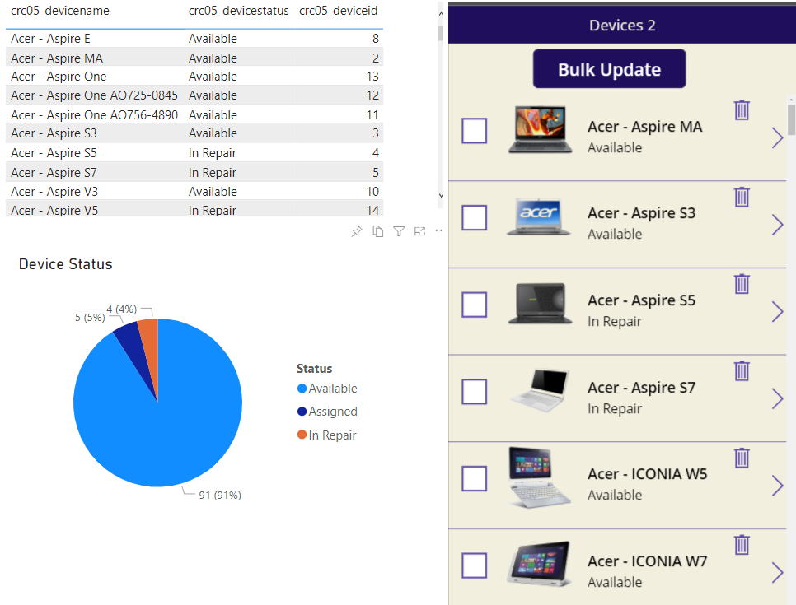
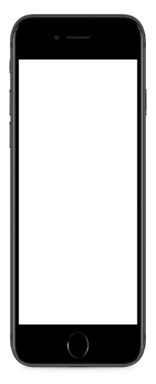
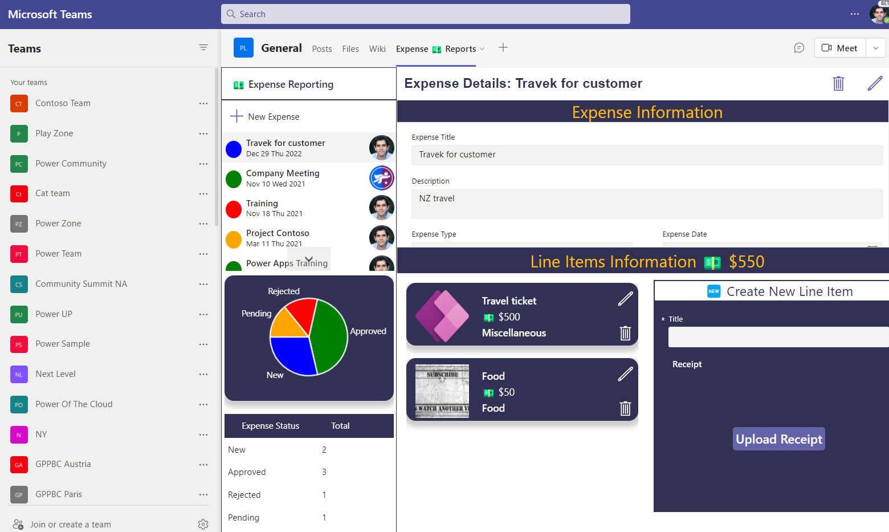


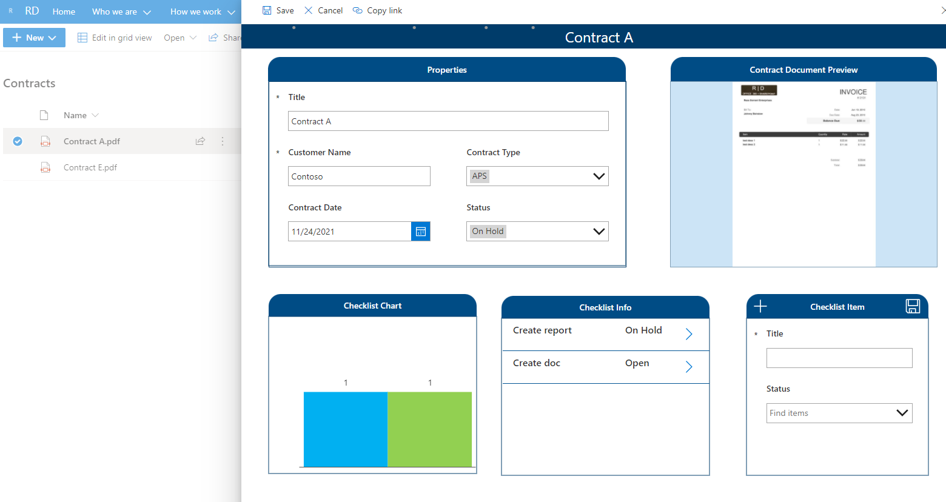
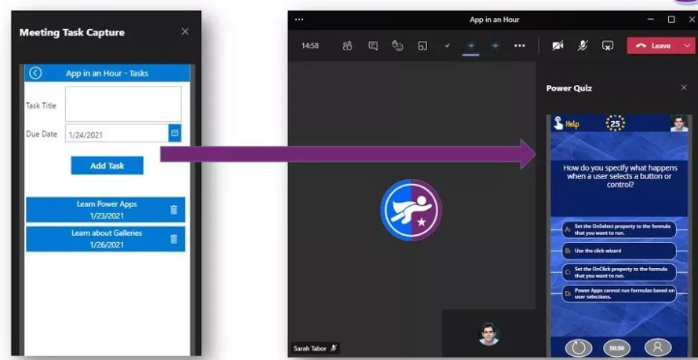
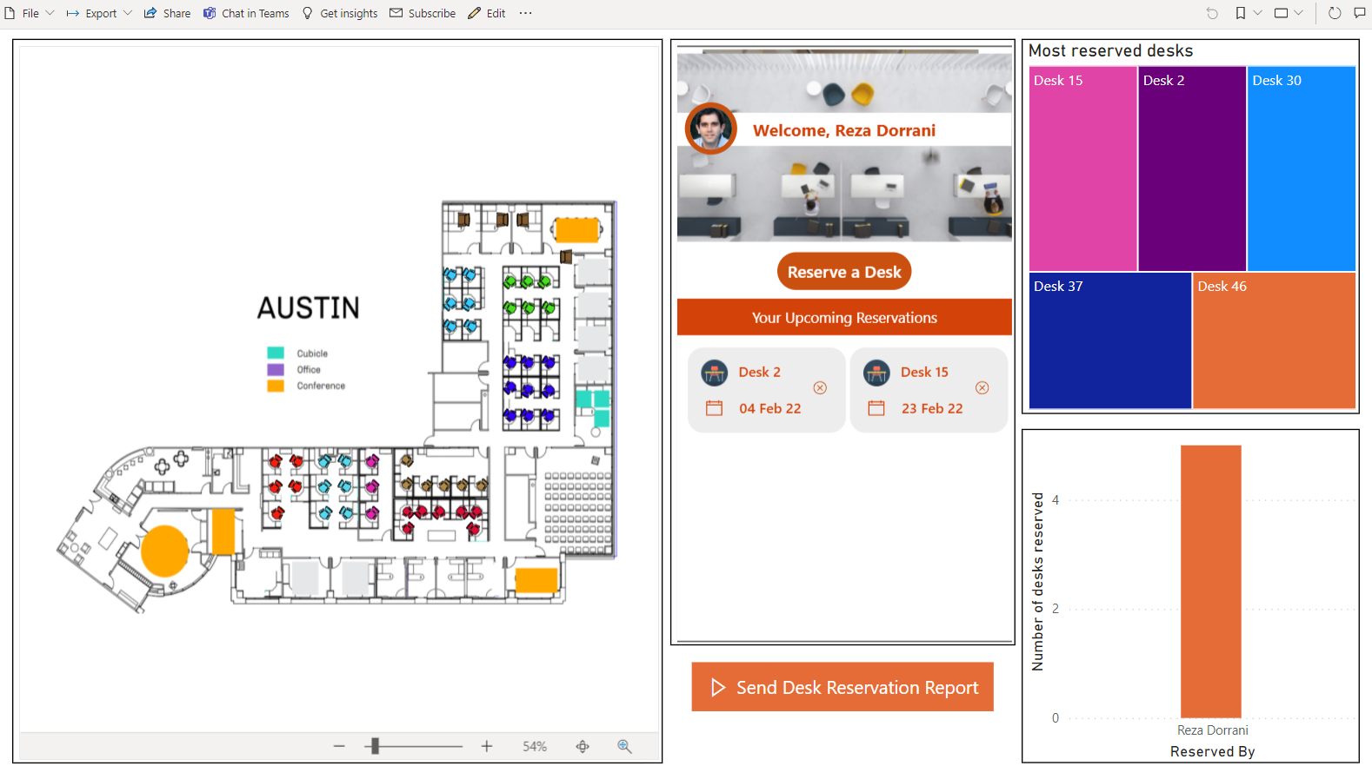
Canvas App Flavors
Standalone Canvas Apps
Power Apps Mobile App.
Build Responsive Apps using containers.
make.powerapps.com
License is based upon connectors used.
SharePoint customized list forms via Power Apps
No more InfoPath please!!!
Customize list/library forms.
Connect to other lists & data sources.
Not Responsive.
Dataverse for Teams Apps
Runs in Teams context only.
Built in Teams.
Dataverse for Teams standard feature (2GB database limit).
Build Responsive Apps using containers.
Power BI Connected Apps
App gets data from Power BI data set.
App can refresh Power BI Visuals (Direct Query)
App license needed (based on connector).

Slide 15
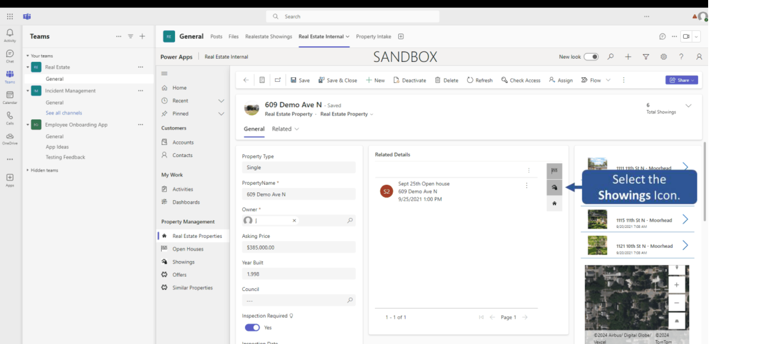
Power Apps in Teams

Slide 16
When to start with Canvas Apps
Low Code (Excel & PowerPoint Skills)
Build Pixel Perfect Apps, full control over the App Design.
Build Task-based & role-based apps.
Mix & Mash-up data from 600+ data sources (integrate with data sources).
Rich integration features (SharePoint, SQL, Power Automate, Power BI, etc.)
Native Mobile Capabilities (Camera, Location etc.)
Licensing (If standard connectors are used)
Data source is not Dataverse. (If you are already invested in other data sources e.g. SharePoint, SQL)

Slide 17
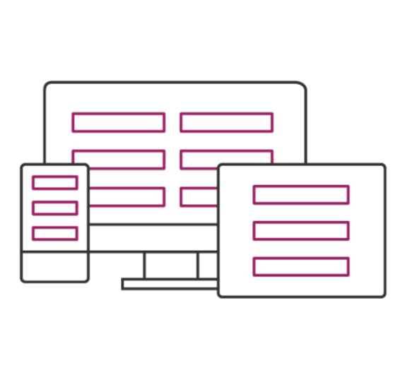



2. Model-driven Apps
Component focused approach to App development without writing code.
Built on Microsoft Dataverse as the data model, manage relationships, and business processes, build end-to-end business applications, immersive and responsive applications.
Rich component-focused no-code design environments
Easily add Business rules and Business process flows to model your business processes
Complex responsive apps on web and mobile

Slide 18
2. Model-driven app components overview
Data components
UI components
Logic components
Visualizations
App | Determines the application fundamentals such as components, properties, client type, and URL for your app.
Site map | Specifies the navigation for your app.
Form | A set of data-entry columns for a given table that matches the items that your organization tracks for the table. For example, a set of data-entry columns where users input relevant information to track a customer's previous orders along with specific requested reorder dates.
View | Views define how a list of rows for a specific table is displayed in your application. A view defines the columns to display, width of each column, sort behavior, and the default filters.
Custom page (preview) | A canvas based page which allows flexible layout, low-code Fx functions, and Power Apps connector data. For more information, see Model-driven app custom page overview (preview)
Business process flow | An online process that walks users through a standard business process. For example, use a business process flow if you want everyone to handle customer service requests the same way, or to require staff to gain approval for an invoice before submitting an order.
Workflow | Workflows automate business processes without a user interface. Designers use workflows to initiate automation that doesn't require any user interaction.
Actions | Actions are a type of process that let you manually invoke actions, including custom actions, directly from a workflow.
Business rule | Used to apply rule or recommendation logic to a form, such as to set column requirements, hide columns, or validate data. App designers use a simple interface to implement and maintain fast-changing and commonly used rules.
Power Automate Flow | Power Automate is a cloud-based service that lets you create automated flows between apps and services to get notifications, synchronize files, collect data, and more.
Chart | A single graphic visualization that can be displayed within a view, on a form, or be added to a dashboard.
Dashboard | Functions as a palate for one or more graphic visualizations that provide an overview of actionable business data.
Embedded Power BI | Add embedded Power BI tiles and dashboards to your app. Power BI is a cloud-based service that provides business intelligence insight.
Table | A container for records with properties that you track, such as a contact or account. Many standard tables are available. You can customize a non-system standard table (production table) or create a custom table from scratch.
Relationship | Table relationships define how tables can be related to each other. There are 1:N (one-to-many), N:1 (many-to-one), and N:N (many-to-many) types of relationships. For example, adding a lookup column to a table creates a new 1:N relationship between the two tables and lets you put that lookup column on a form.
Column | A property that is associated with a table. A column is defined by a data type, which determines the type of data that can be entered or selected. Examples include text, number, date and time, currency, or lookup (creates a relationship with another table). Columns typically are used with forms, views, and searches.
Choice column | This is a special type of column, which provides the user a set of predetermined options. Each option has a number value and label. When added to a form, this column displays a control for the user to select an option. There are two kinds of choices; choices, where the user can only select one option, and multi-select choices, which allow more than one selection.

Slide 19
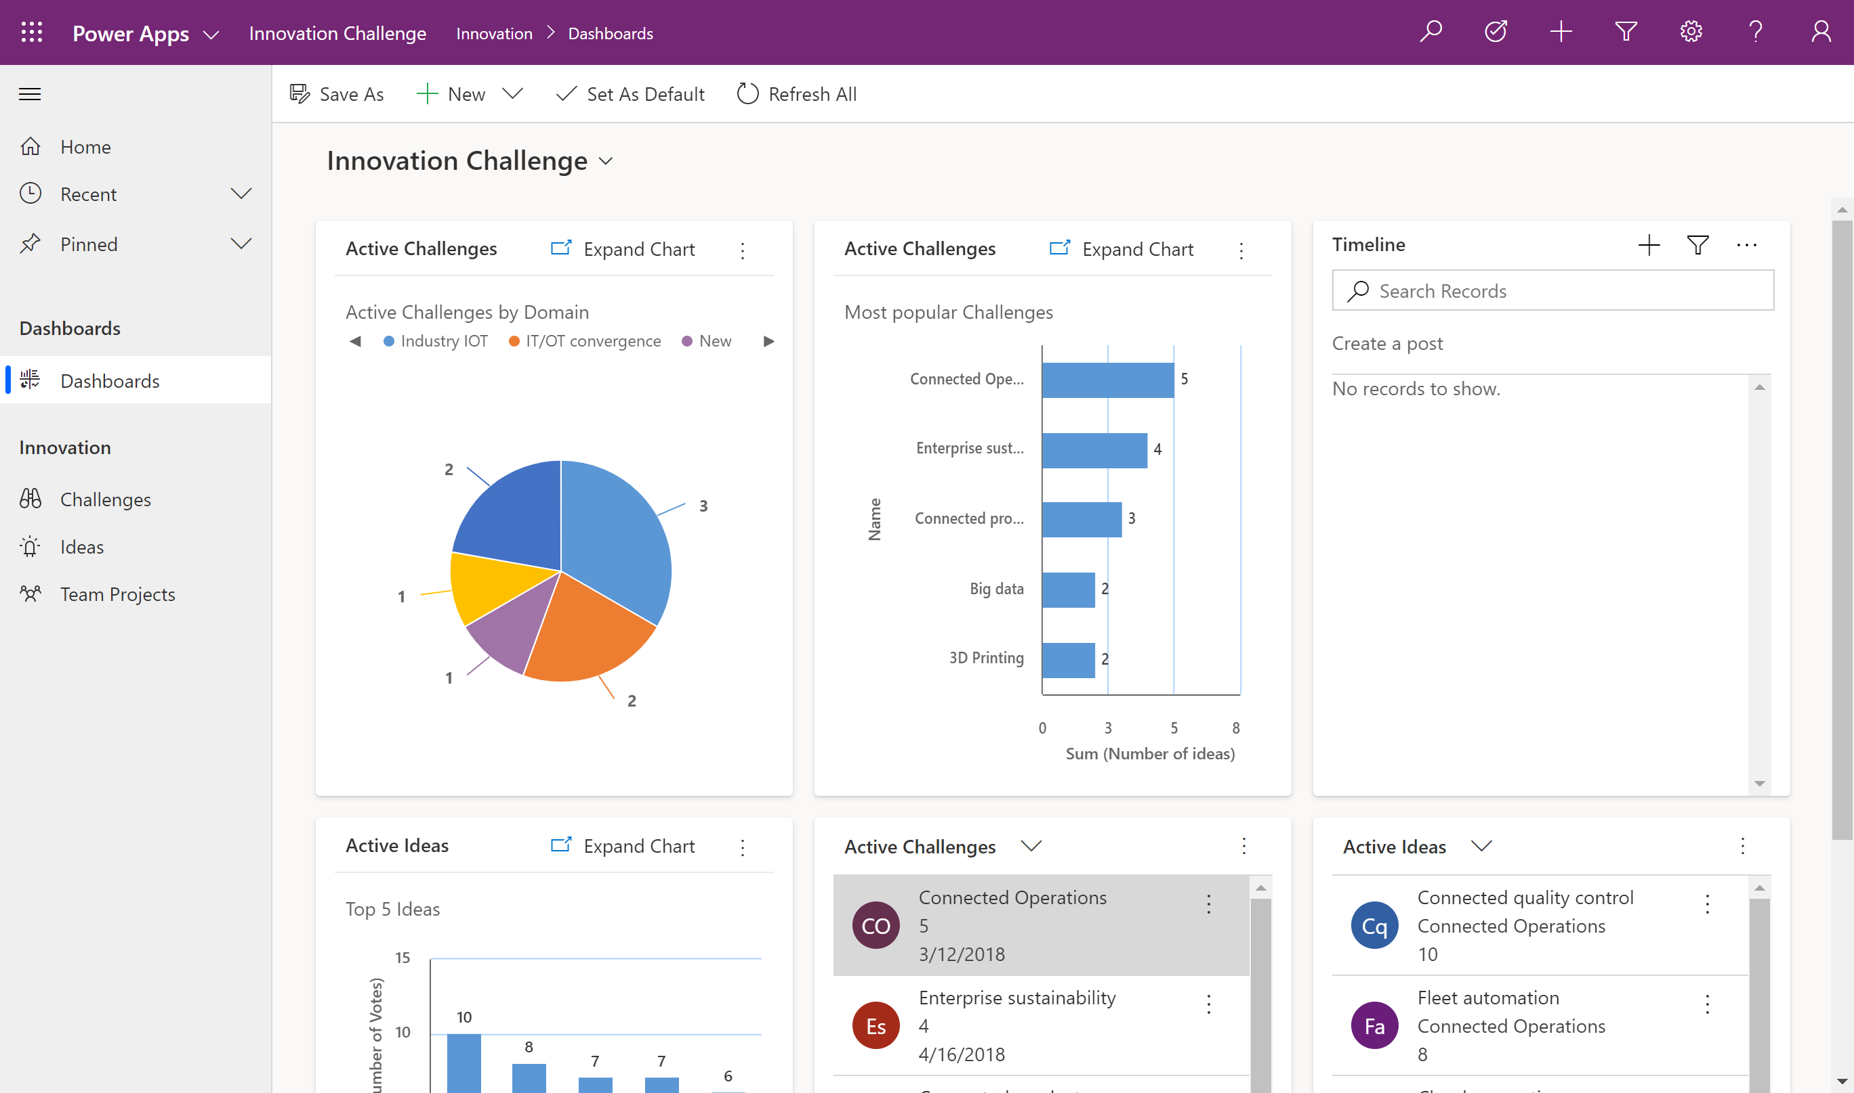
In this example, the app contains three tables (challenges, ideas, team projects), one dashboard, and multiple charts and views. Users can navigate between the tables using the left pane or via the dashboard.

Slide 20
When to start with 2. Model-Driven Apps
No-Code
Leverages Dataverse - Same database that Dynamics 365 is built on.
Component focused approach with Relationship driven architecture.
Focus on the data model.
Responsive by design.
App adapts to changes in data model & security.
Leverage Business Process flows, Business Rules, Forms , Views, Charts etc.
Common user tooling functionality (import, export, sort, filter etc.).
Native Offline Capabilities.
Delegation challenges averted.
Invested in Premium License or Dynamics 365.

Slide 21
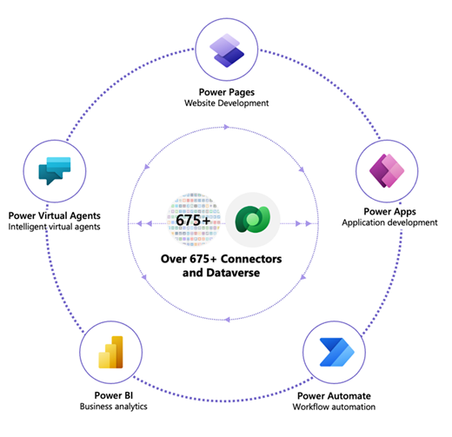
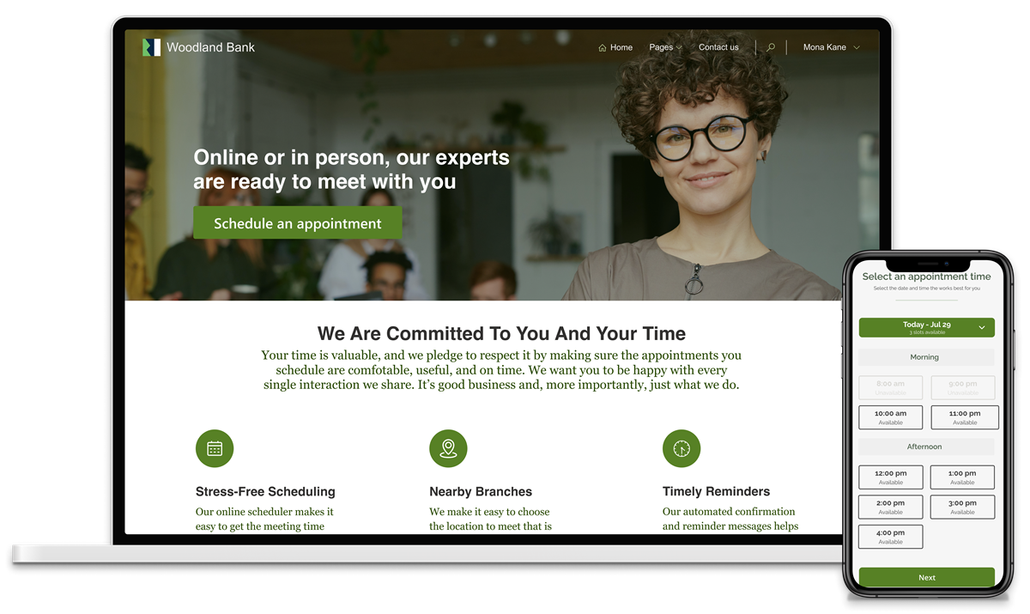
3. Power Pages (Power Portal) – now independent

Slide 22
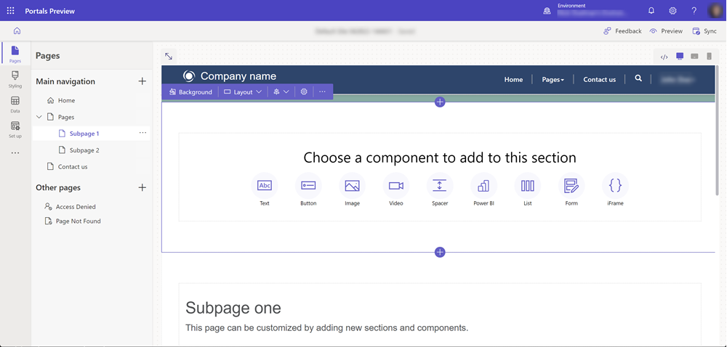
3. Power page . Option customize in Design studio

Slide 23
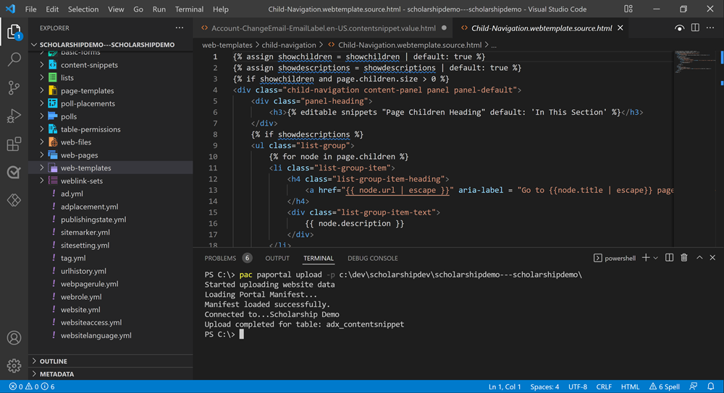
3. Power Pages customization : Makers with VS Code

Slide 24

Thank You

