Slide 1
8
th
DOT NET DAY
https://www.mdcahmedabad.com
SPEAKERS

Slide 2
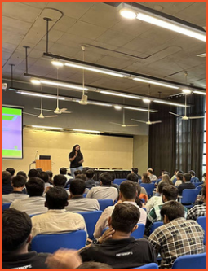
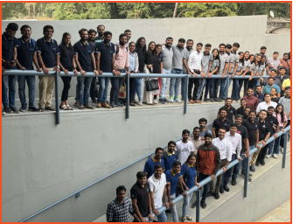
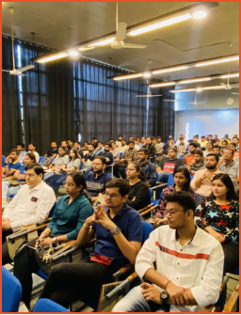
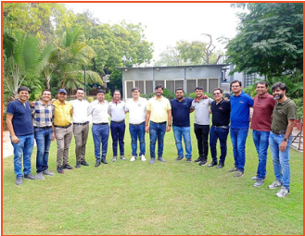
Implementing Intelligent Solutions with Microsoft .NET

Slide 3
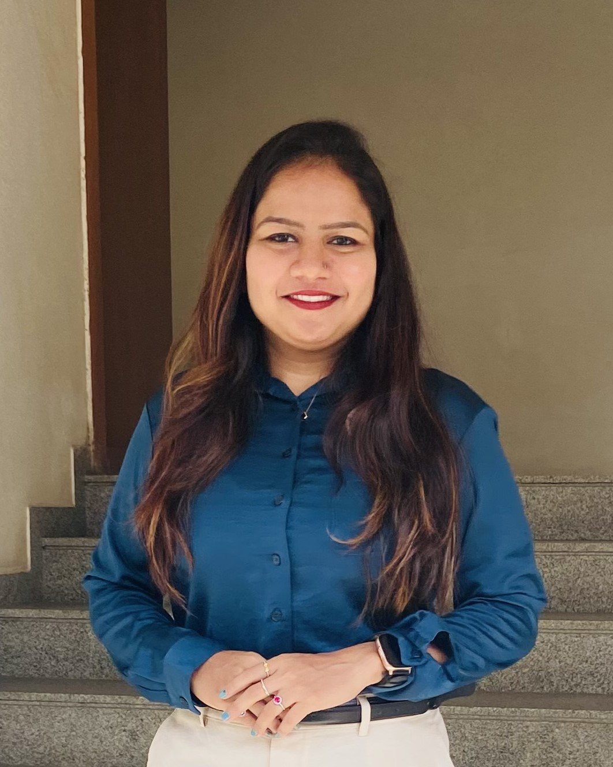
SPEAKER
Jinkal Radadiya
AVP - Project Delivery
IT Path Solutions

Slide 4
Agenda
AI and Technology Support
Challenges with .NET
.NET Support for AI
Demo Time
Key Features and Benefits
Real-World Use Cases
Q&A

Slide 5
AI and Technology Support
i.e, PyTorch, LangChain
i.e, TensorFlow.js, Brain.js

Slide 6
Challenges
No easy way to add AI to .NET apps
Inconsistent APIs across AI providers
Existing tools feel clunky or limited
.NET devs forced to adapt or start from scratch
Leads to inefficiency and lost potential

Slide 7
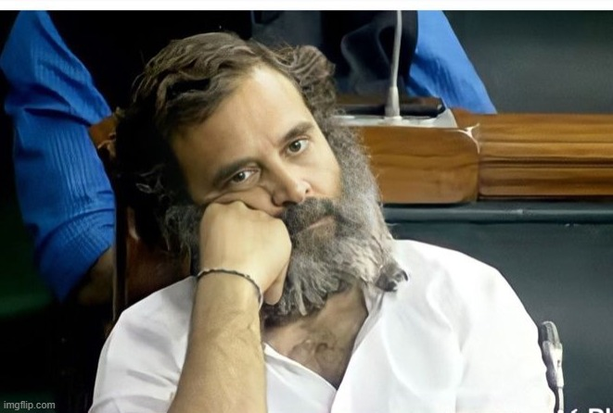
Solution??

Slide 8
Microsoft.Extensions.AI
Released on October 2024
Unified abstraction layer for integrating AI services
Enable flexibility across AI providers (e.g., OpenAI, Azure AI, Ollama)
Empower developers to focus on app logic, not provider-specific code

Slide 9
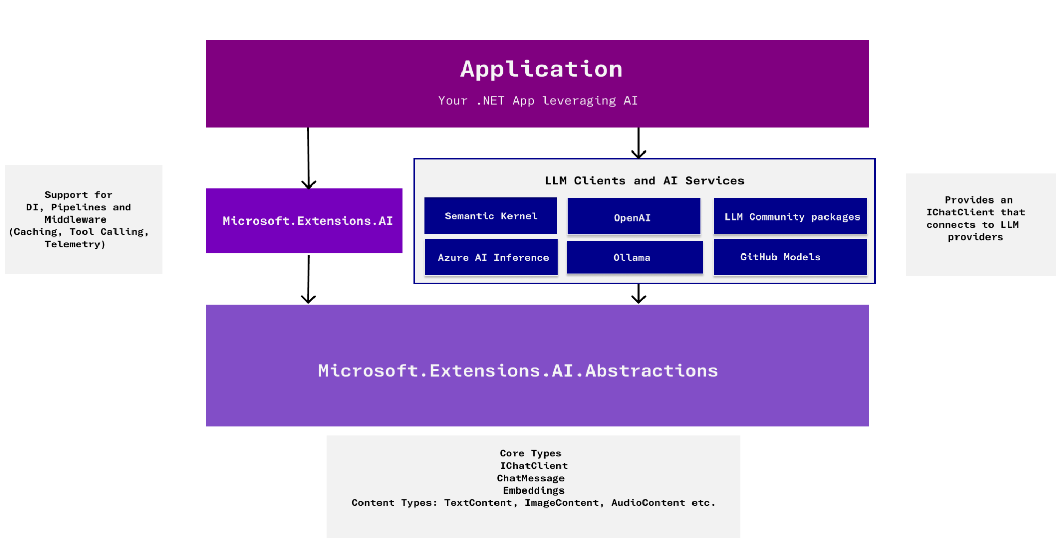
Architecture

Slide 10
Building Blocks
IChatClient
Responsible for interacting with AI services.
ChatMessage
Represents a chat message used by an IChatClient
ChatRole
System
Assistant
User

Slide 11
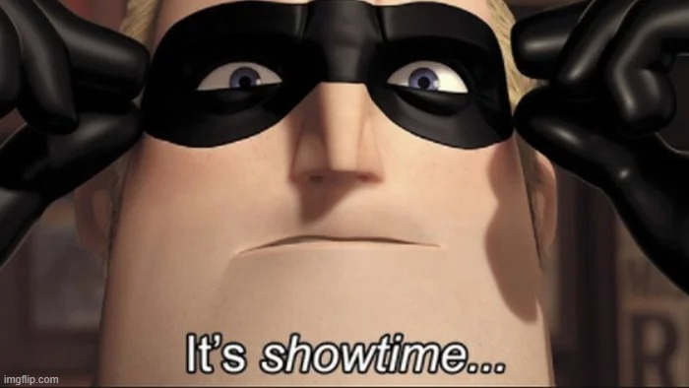

Slide 12
Example Models
Chat Completion Models
gpt-4o
gpt-4o-mini
o1
Embedding Models
text-embedding-3-small
text-embedding-3-large
text-embedding-ada
text-search-davinci-001
Other Providers
grok
claude-3-sonnet
gemini-1.5-pro
Open-Source Models
all-MiniLM
BGE-M3
E5-mistral-7b
llama-3.3
mixtral-8x7b

Slide 13
Key Features
Tool/Function Calling
Chat Streaming
Embedding Generator
Provides Telemetry
Support for Caching
Middleware Support
Seamlessly integrate with Semantic Kernel, dependency injection, and other .NET tools

Slide 14
Real-World Use Cases
Chatbots
Content/Doc Summarization
Smart Search
Context-Aware Virtual Assistant for Internal Teams
Meeting Notes Summarization
Invoice Processing and Data Extraction
Fraud Detection in Financial Transactions

Slide 15
The Bigger Picture
Why Now?
AI is changing how apps work
C# devs are needed more than ever
Microsoft.Extensions.AI makes it easy—no PhD needed
Key Takeaways
Use your .NET skills to build smart apps
Now’s the time to lead the AI wave in .NET

Slide 16
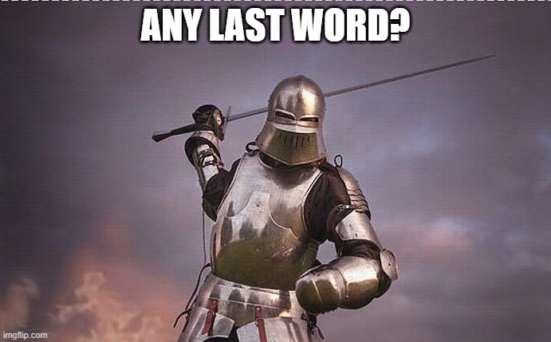

Slide 17
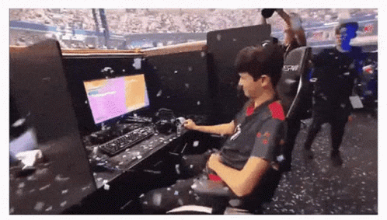

Slide 18
SPONSORS
THANK YOU
Stay Tuned For 9th Dot Net Day

