Slide 1
8
th
DOT NET DAY
https://www.mdcahmedabad.com
SPEAKERS

Slide 2
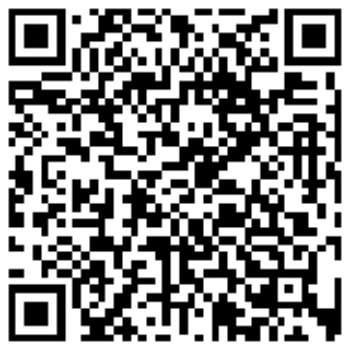
Introduction
Jinesh Shah
CTO & Co-founder
https://www.linkedin.com/in/shahjinesh11/

Slide 3
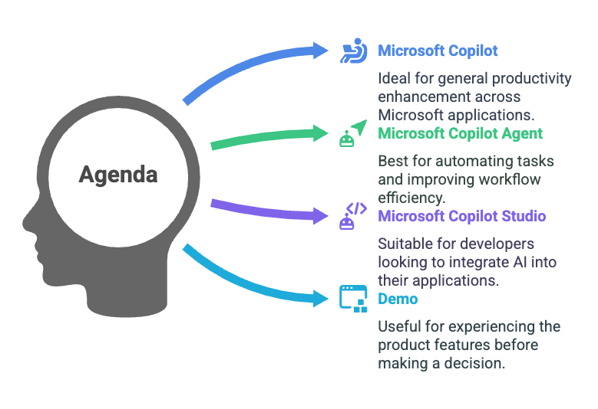
Agenda
Credits: Napkin.ai

Slide 4
Microsoft Copilot
Overview: Microsoft Copilot is an AI-powered assistant designed to enhance productivity and efficiency.
Key Features: Integration with Microsoft 365, contextual understanding, task automation.
Benefits: Streamlines workflows, improves accuracy, and saves time.

Slide 5
Microsoft Copilot Agent
A Microsoft Copilot Agent is an AI-driven assistant that enhances productivity by automating tasks, providing insights, and offering personalized assistance.
Key Features:
Task Automation: Automate repetitive tasks to save time and reduce errors.
Personalized Assistance: Tailor the agent to provide suggestions and insights based on user preferences and organizational data.
Integration: Seamlessly integrate with Microsoft 365 apps like Word, Excel, and Teams, as well as other tools and workflows.
Customizability: Use Copilot Studio to create and configure agents using natural language
Benefits:
Enhanced Productivity: Streamline workflows and improve efficiency.
Improved Accuracy: Ensure consistency in task execution.
Personalized Experience: Customize the agent to meet specific needs and preferences

Slide 6
Microsoft Copilot Studio
Copilot Studio allows you to build your own AI-powered copilots (agents) using a no-code or low-code platform.
Drag-and-drop interface
Connects with Microsoft ecosystem (Power Automate, Teams, etc.)
Create custom workflows and bots

Slide 7
Demo
AI in Action
Leveraging MDCA Website to Build a Copilot Agent as Advisor

Slide 8
SPONSORS
THANK YOU
Stay Tuned For 9th Dot Net Day

