Slide 1



10
th
DOT NET DAY
https://www.mdcahmedabad.com

Slide 2


Top 10 Security Misconfigurations in .NET Web Apps
And How to Fix Them
by
Smit Shah
from
A CERT-In Empaneled Cybersecurity Auditor

Slide 3


A CERT-In Empaneled Cybersecurity Auditor
:~$WHOAMI > SMIT SHAH (https://in.linkedin.com/in/smitbshah)
:~$ 10+ Years experienced Ethical Hacker, Security Researcher, Bug Bounty Hunter & an Entrepreneur
:~$ Co-founder & CEO of eSecurify Technologies LLP
:~$ Securing 100+ Banks, 50+ Stock Brokers & 150+ SaaS Products across the globe
:~$ Acknowledged as “Most Valued Hacker” by Hackerone
:~$ Proud Member of Synack Red Team (SRT)
:~$ Speaker at International Security Conference CS7, TheHackersMeetup, GDG Devfest Ahmedabad, ICAI Surat, ICAI Jamnagar, and many more
:~$ Appeared on TechnoGuru Show by GSTV on every Saturday
:~$ Live Talk Show on GSTV, GTPL & Sandesh for various cyber crime frauds
:~$ Young Achiever’s Award by Marwadi University

Slide 4
A CERT-In Empaneled Cybersecurity Auditor
Why Security Matters?
:~$ Cyberattacks on web applications have increased by 250% in the last 3 years
:~$ 70% of breaches happen due to exploitable vulnerabilities in application code
:~$ A single security flaw can expose customer data, business reputation, and revenue
:~$ Modern .NET applications are complex - APIs, cloud, microservices, etc. increasing attack surface
Security is no longer optional, it must be part of development

Slide 5
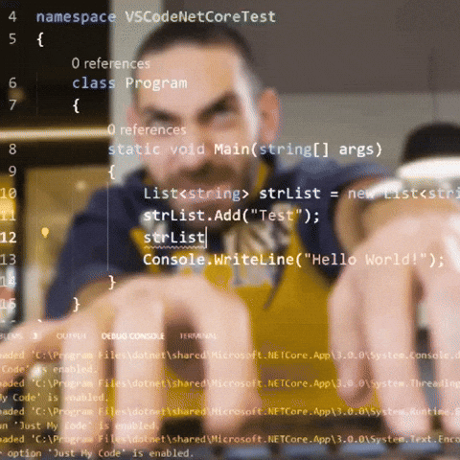
A CERT-In Empaneled Cybersecurity Auditor
How Attackers Think?

Slide 6
A CERT-In Empaneled Cybersecurity Auditor
How Attackers Think?
:~$ Attackers don’t follow application rules & validations
:~$ They input what the system doesn’t expect
:~$ They look for trust boundaries to break
:~$ Their goal: an entry point → privilege → data
Security Thumb Rule says “Never Trust User Input”

Slide 7
A CERT-In Empaneled Cybersecurity Auditor
OWASP Top 10 : 2021 - Vulnerability Categories
:~$ A01: Broken Access Control
:~$ A02: Cryptographic Failures
:~$ A03: Injection
:~$ A04: Insecure Design
:~$ A05: Security Misconfiguration
:~$ A06: Vulnerable and Outdated Components
:~$ A07: Identification and Authentication Failures
:~$ A08: Software and Data Integrity Failures
:~$ A09: Security Logging and Monitoring Failures
:~$ A10: Server-Side Request Forgery (SSRF)

Slide 8
A CERT-In Empaneled Cybersecurity Auditor
1. SQL Injection on Login & Web Forms
SQL Injection in login query leads to full bypass
Dangerous input: 0' OR '0'='0
Occurs due to string-based dynamic SQL
Impact: Account takeover + admin access + database access
Let’s proceed with Live Demo

Slide 9
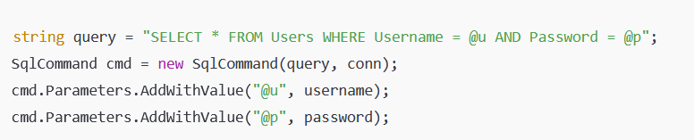
A CERT-In Empaneled Cybersecurity Auditor
How to Fix SQL Injection?
Always use parameterized queries
EF/LINQ instead of raw SQL
Password hashing
Input validation

Slide 10
A CERT-In Empaneled Cybersecurity Auditor
2. OTP Bypass via Brute force
OTP Brute force Attack
OTP validation endpoint accepts unlimited attempts.
Weak OTP (4–6 digits) → trivial to crack.
No IP/device throttling → attacker cycles through all combinations.
Impact: Full account takeover via credential-less login.
Let’s proceed with Live Demo

Slide 11
A CERT-In Empaneled Cybersecurity Auditor
How to Fix OTP Bypass via Brute force?
Enforce rate limiting (per IP + per user).
Lock OTP after 3–5 failed attempts.
Use randomized, high-entropy OTPs (6–8 digits).
Bind OTP to session + device fingerprint.
Alert on abnormal OTP retries.

Slide 12
A CERT-In Empaneled Cybersecurity Auditor
3. OTP Exposure in Responses/Logs
Backend returns OTP in API response, server logs, console logs, monitoring tools.
Attacker with log/API access gets OTP directly.
Impact: Instant account compromise.
Let’s proceed with Proof of Concept

Slide 13
A CERT-In Empaneled Cybersecurity Auditor
How to Fix OTP Leakage?
Never return OTP in API responses.
Disable OTP logging at app/server levels.
Mask sensitive auth values in monitoring tools.
Implement strict log access controls.

Slide 14
A CERT-In Empaneled Cybersecurity Auditor
4. Missing Rate Limiting on Auth Flows
No Rate Limits = Unlimited Attacks
Login/OTP/Reset endpoints allow infinite attempts.
Bruteforce, credential stuffing, and enumeration become easy.
Impact: Credential compromise, account takeover.

Slide 15
A CERT-In Empaneled Cybersecurity Auditor
How to Fix Missing Rate Limiting?
Add strict per-IP and per-user throttling.
Use CAPTCHA on repeated failures.
Block automated traffic with WAF rules.
Monitor login anomaly patterns.

Slide 16
A CERT-In Empaneled Cybersecurity Auditor
5. Forced Browsing to Admin/Internal Paths
Unauthorized Direct Access
Admin paths accessible without proper auth/role checks.
Users simply browse: /admin, /internal, /config.
Impact: Privilege escalation + data exposure.
Let’s check Proof of Concept

Slide 17
A CERT-In Empaneled Cybersecurity Auditor
How to Fix Forced Browsing?
Enforce role validation on every admin endpoint.
Hide internal admin URLs behind authenticated sessions.
Use RBAC with server-side enforcement.
Block direct access to sensitive routes using strict access-control middleware.

Slide 18
A CERT-In Empaneled Cybersecurity Auditor
6. JWT Token Manipulation
JWT Tampering
Weak signing key or “alg=none” allows attacker to modify JWT payload.
Privilege escalation by editing role: admin.
Impact: Full privilege takeover.

Slide 19
A CERT-In Empaneled Cybersecurity Auditor
How to Fix JWT Manipulation?
Use HS256/RS256 with strong keys.
Never allow alg=none.
Validate signature and expiration strictly.
Store sensitive permissions server-side, not in JWT.

Slide 20
A CERT-In Empaneled Cybersecurity Auditor
7. JSON Parameter Tampering / Mass Assignment
Mass Assignment
API accepts arbitrary JSON fields.
Attacker adds unauthorized fields:
{ "role": "admin", "isPremium": true }
Impact: Privilege escalation, business logic abuse.
Let’s check Proof of Concept

Slide 21
A CERT-In Empaneled Cybersecurity Auditor
How to Fix JSON Tampering?
Allowlist permitted fields server-side.
Reject extra/unexpected JSON parameters.
Don’t bind sensitive fields directly to models.
Block updates to sensitive fields server-side.

Slide 22
A CERT-In Empaneled Cybersecurity Auditor
8. Remote Code Execution (Deserialization / ViewState / Telerik)
RCE via Unsafe Deserialization
Unvalidated ViewState, Telerik, or binary objects allow attacker-controlled code execution.
Attackers can craft malicious serialized payloads that execute arbitrary commands the moment the application attempts to deserialize them.
Impact: Full server takeover.

Slide 23
A CERT-In Empaneled Cybersecurity Auditor
How to Fix RCE via Deserialization?
Use signed & encrypted ViewState.
Patch known Telerik/ViewState CVEs.
Avoid insecure binary deserialization.
Implement strong input validation.

Slide 24
A CERT-In Empaneled Cybersecurity Auditor
9. Arbitrary File Upload → Webshell
Unrestricted File Upload
Attacker uploads PHP/JSP/ASPX shell disguised as image.
Server executes the file → remote command execution.
Impact: Full server compromise.
Let’s check Proof of Concept

Slide 25
A CERT-In Empaneled Cybersecurity Auditor
How to Fix Arbitrary File Upload?
Validate file type, extension, and MIME.
Use allowlist (images only).
Store files outside Webroot.
Rename files and remove executable permissions.

Slide 26
A CERT-In Empaneled Cybersecurity Auditor
10. Cross Site Scripting (XSS)
Injecting malicious JS into web pages
Caused by unsafe output encoding
Impact: session theft, redirect, data theft
Let’s check a Live Demo

Slide 27
A CERT-In Empaneled Cybersecurity Auditor
How to Fix XSS?
Input Sanitization
Output Encoding using AntiXSS Encoders
Set HTTPOnly flag on Cookie
Restrict or Whitelist 3rd Party Scripts using CSP

Slide 28
A CERT-In Empaneled Cybersecurity Auditor
Any Questions?

Slide 29

SPONSORS
THANK YOU
Stay Tuned For 11th Dot Net Day

