Slide 1



10
th
DOT NET DAY
https://www.mdcahmedabad.com

Slide 2



Introduction
Upendrasinh Zala
Director and CEO

Slide 3
“Taming the AI IDE: Coding in Harmony, Not Chaos”

Slide 4


Important Announcement

Slide 5
Method Of Vibe Coding
Zero Step Single Shot
Incremental Multi Step Shot

Slide 6
Vibe Coding
Phrase:
The Fastest Coders Deploy Constantly
Keywords (same as before):
1.⁠ ⁠T → Thinking
2.⁠ ⁠F → Framework
3.⁠ ⁠C - Checkpoints
4.⁠ ⁠D → Debugging
5.⁠ ⁠C → Context

Slide 7

Let’s Start with You 👋
Post-AI, what is the most painful challenge you’ve faced inside your AI-IDE?

Slide 8
Let’s Life After AI IDEs
We Didn’t Just Add AI… We Changed How We Code
We moved from “I write code, IDE assists” -> “AI writes code, I try to control it”
We opened Cursor / Claude / Copilot and said: ”Build this whole feature for me.”

Slide 9
Common Mistakes I See Everywhere
No standard format
Writing or using SOPs only in your head
Project import & structure randomly
Zero code standards

Slide 10
Mistake 1: No standard format
We paste boilerplates or AI-generated “standard” setup:
auth, router, store, layout… in one shot
But:
    No one actually reads the generated structure
    The team doesn’t know why these patterns exist
    AI just picked a random “standard” from its training data
Result:
Over-engineered or wrong architecture for a simple problem
Fear of touching “AI code” later

Slide 11
Mistake 2: No SOP, Only Prompts
Every dev has their own way of talking to AI:
“Bro, create API for this”
“Refactor this mess”
“Make it production ready”
No shared SOP like:
Where to keep requirements
How to describe tasks to AI
How to review AI output
Result:
Different “coding styles” across the same repo.
AI producing inconsistent patterns.
Harder onboarding for new devs.

Slide 12
Mistake 3: Just Index the Repo, It’ll Figure It Out”
We drag-and-drop an existing project into Cursor / AI IDE and assume:
“Now AI understands everything.”
Every dev has their own way of talking to AI:
Common issues:
AI reads random files, ignores real entry points
Old, dead code confuses the model
No clear architecture map for the AI
Result:
AI suggests code for the wrong tech stack
Refactors the wrong layer
Touches files that should be frozen

Slide 13
Mistake 4: Letting AI Decide Your Code Style
No documented:
Naming conventions or Folder structure
Error handling pattern
Testing approach
AI will:
Mixes styles from different projects
Writes tests in one style, code in another
Uses libraries you don’t even use elsewhere
Result:
Code works today, but becomes unmaintainable quickly

Slide 14
Don’t Ask “Which AI Tool?” – Ask “What Is Our Procedure?”
Tools are not the problem. Our missing procedure is
They need:
Clear vibes (how they should behave)
Clear boundaries
Clear structure in the repo

Slide 15
Standard Procedure for Vibe Coding (High-Level)
Use “Ask / Plan / Agent” features
Review, test, and commit yourself
(AI is the assistant, you remain the author.)

Slide 16
Standard Procedure for Vibe Coding (High-Level)
Define the “vibe” of your project
(Tech stack, patterns, tone, constraints)
Create context files inside “.cursor / .claude / .codex” folder.
architecture.md
requirements.md
api-contracts.md
coding-standards.md

Slide 17
Real Examples

Slide 18
Project Context File
Sample

Slide 19
Formatting Rules File
Sample

Slide 20
Naming Conventions File
Sample

Slide 21
Restricted File Rule File
Sample

Slide 22
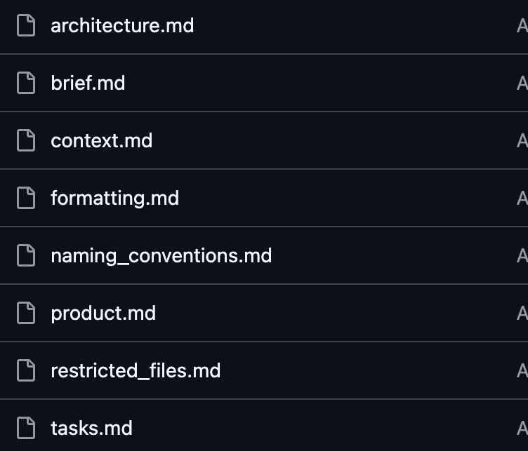
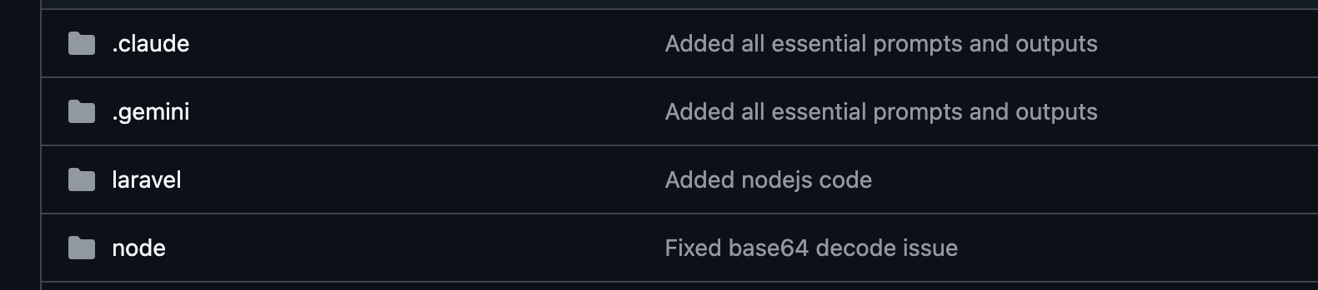
Where to put this Files???

Slide 23
Remember Only 3 Things…
AI IDEs are powerful, but without SOP they lead to chaos.
Treat AI as your assistant with superpowers,
Not an auto-pilot.
Put your architecture, standards & rules inside the repo.

Slide 24

QUESTION ?
Let’s make AI feel like a trusted teammate, not a risky shortcut

Slide 25
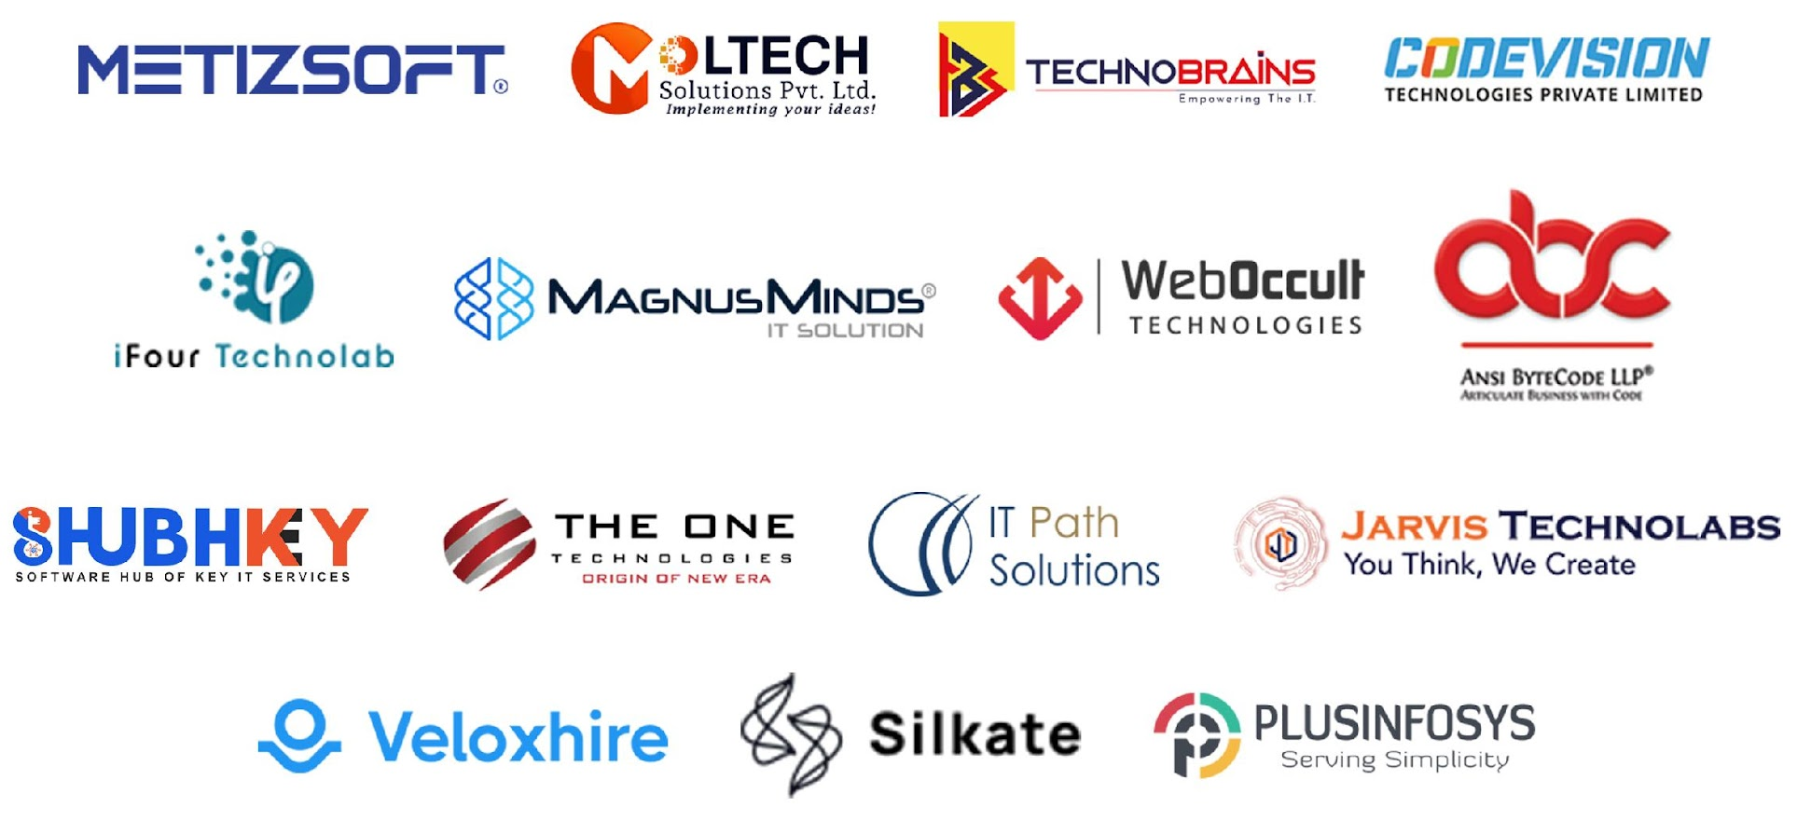

SPONSORS
THANK YOU
Stay Tuned For 10th Dot Net Day

